Slide 1
E-COMMERCE WEBSITE ON COSMETICS…..
By batch : 27

Slide 2
Contents:
Problem Statement
Solution
Alternatives
Flow of Application
Structure
Terminologies
Future Scope

Slide 3
Problem Statement:
Traditional cosmetic shopping lacks personalization and convenience. Inventory and order management in physical stores is inefficient.
To develop a scalable, secure, and user-friendly web application that offers an intuitive frontend, efficient backend operations, and personalized shopping features to improve overall customer experience and streamline business processes.

Slide 4
Solution:
By designing a full-stack e-Commerce platform focused on cosmetics.
Frontend : Clean layout with easy navigation (Home, Product, Cart, Search, Login)
Backend : Powered by .NET Handles business logic, API management.

Slide 5
Alternatives:
AI Skin Analyzers: Personalized product suggestions via webcam photos.
AR Try-On: Real-time virtual makeup application previews.
Chatbots: Instant support with beauty consultants.
Subscription Boxes: AI-based monthly curated product boxes

Slide 6
Flow of Application:
1.User Interaction (Frontend - Angular)
The user begins interaction via the Angular-based frontend:
Navigates through pages: Home, Product, Cart, Search, Login.
Triggers events like: viewing a product, searching, adding to cart, or logging in.
All user actions on the UI result in HTTP requests being sent to the backend through API calls.

Slide 7
2. API Handling (Backend - .NET Core)
The Angular frontend communicates with the backend through RESTful APIs handled by ASP.NET Core.
Controllers in .NET Backend:
ProductsController.cs: Handles product-related requests (get product list, product details, etc.)

Slide 8
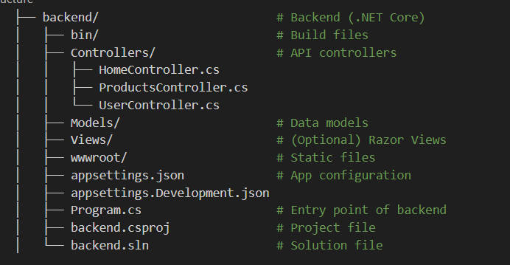
Structure:

Slide 9
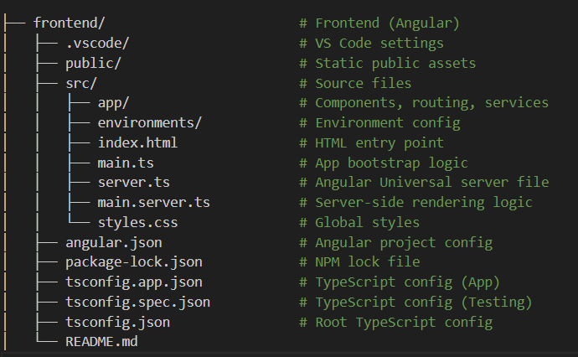
Structure:

Slide 10
Terminologies:
Frontend (Angular)
Component: A self-contained UI block in Angular (e.g., product card, login form).
Module: Groups related components and services. Every Angular app has at least one root module (AppModule).
Service: Used to write logic that can be reused, like calling APIs or managing cart data.
Routing: Navigates between pages (e.g., /home, /product/:id) without reloading the page.
TypeScript: A strongly-typed language that compiles to JavaScript. Angular is built using TypeScript.
Angular CLI: Command Line Interface to generate components, services, and manage builds.

Slide 11
Terminologies:
Backend (.NET Core)
Controller: A class that handles HTTP requests (e.g., HomeController.cs) and returns responses (usually JSON or views).
Model: Represents data structure (like Product, User). Used for binding data between database and frontend.
View: Part of the MVC pattern, used to render UI (optional in API-based projects).
API (Application Programming Interface): A set of endpoints (like /api/products) that frontend calls to get/post data.
Entity Framework: ORM (Object-Relational Mapper) used in .NET to interact with databases using C# instead of SQL.
appsettings.json: Configuration file where it is defined the connection strings, environment variables, etc.

Slide 12
Future Scope:
Cloud Deployment – Scale easily using AWS or Azure
Wishlist & Reviews – Enhance user engagement features
AI Recommendations – Personalized product suggestions
Multilingual Support – Reach a global audience
Progressive Web App (PWA) – Offline support & app-like feel
Advanced Search – NLP or image-based search
Secure Auth – Implement JWT or OAuth2
CI/CD & Docker – Automate deployment & containerize services

